Slide 1

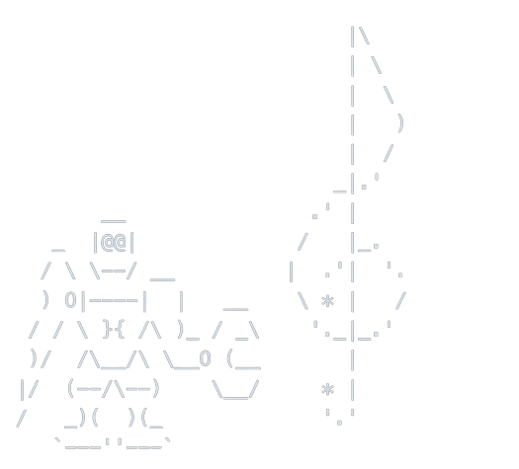
Beat Catcher
microbeat

Slide 2
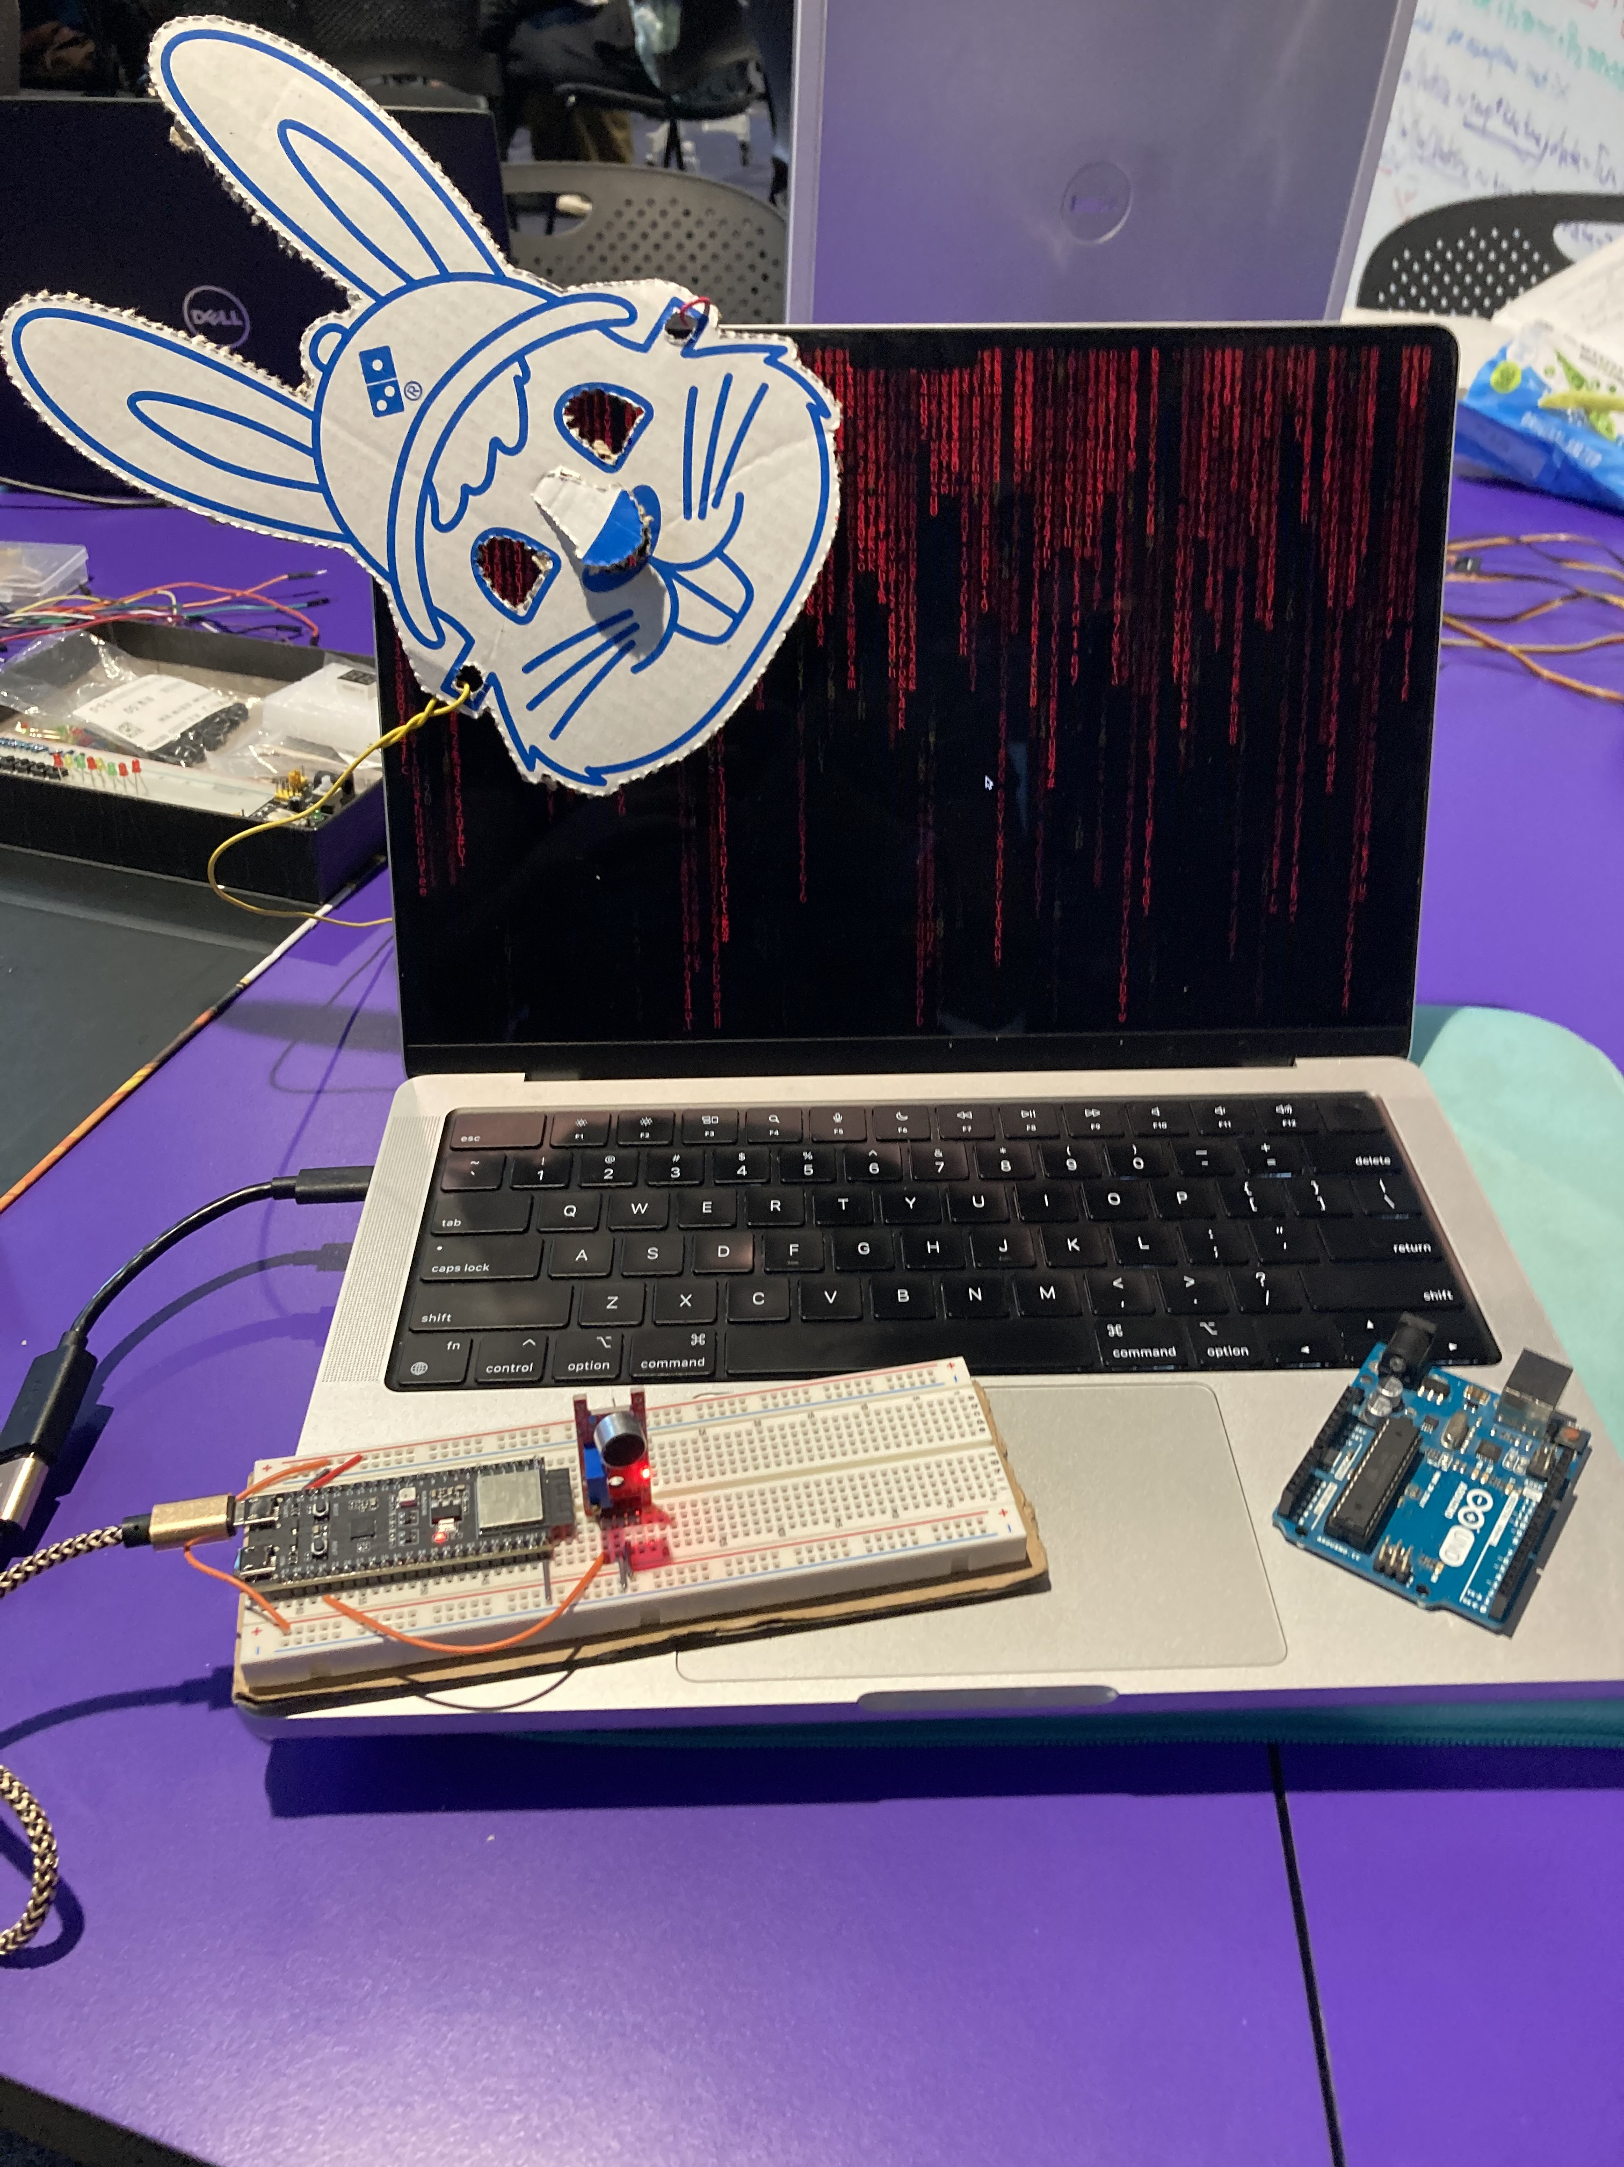
Product

Slide 3
Product
Component List:
ESP32-S3-DevKitM-1
Breadboard & jumper leads
HG-485 sound sensor
M2 Macbook Pro

Slide 4
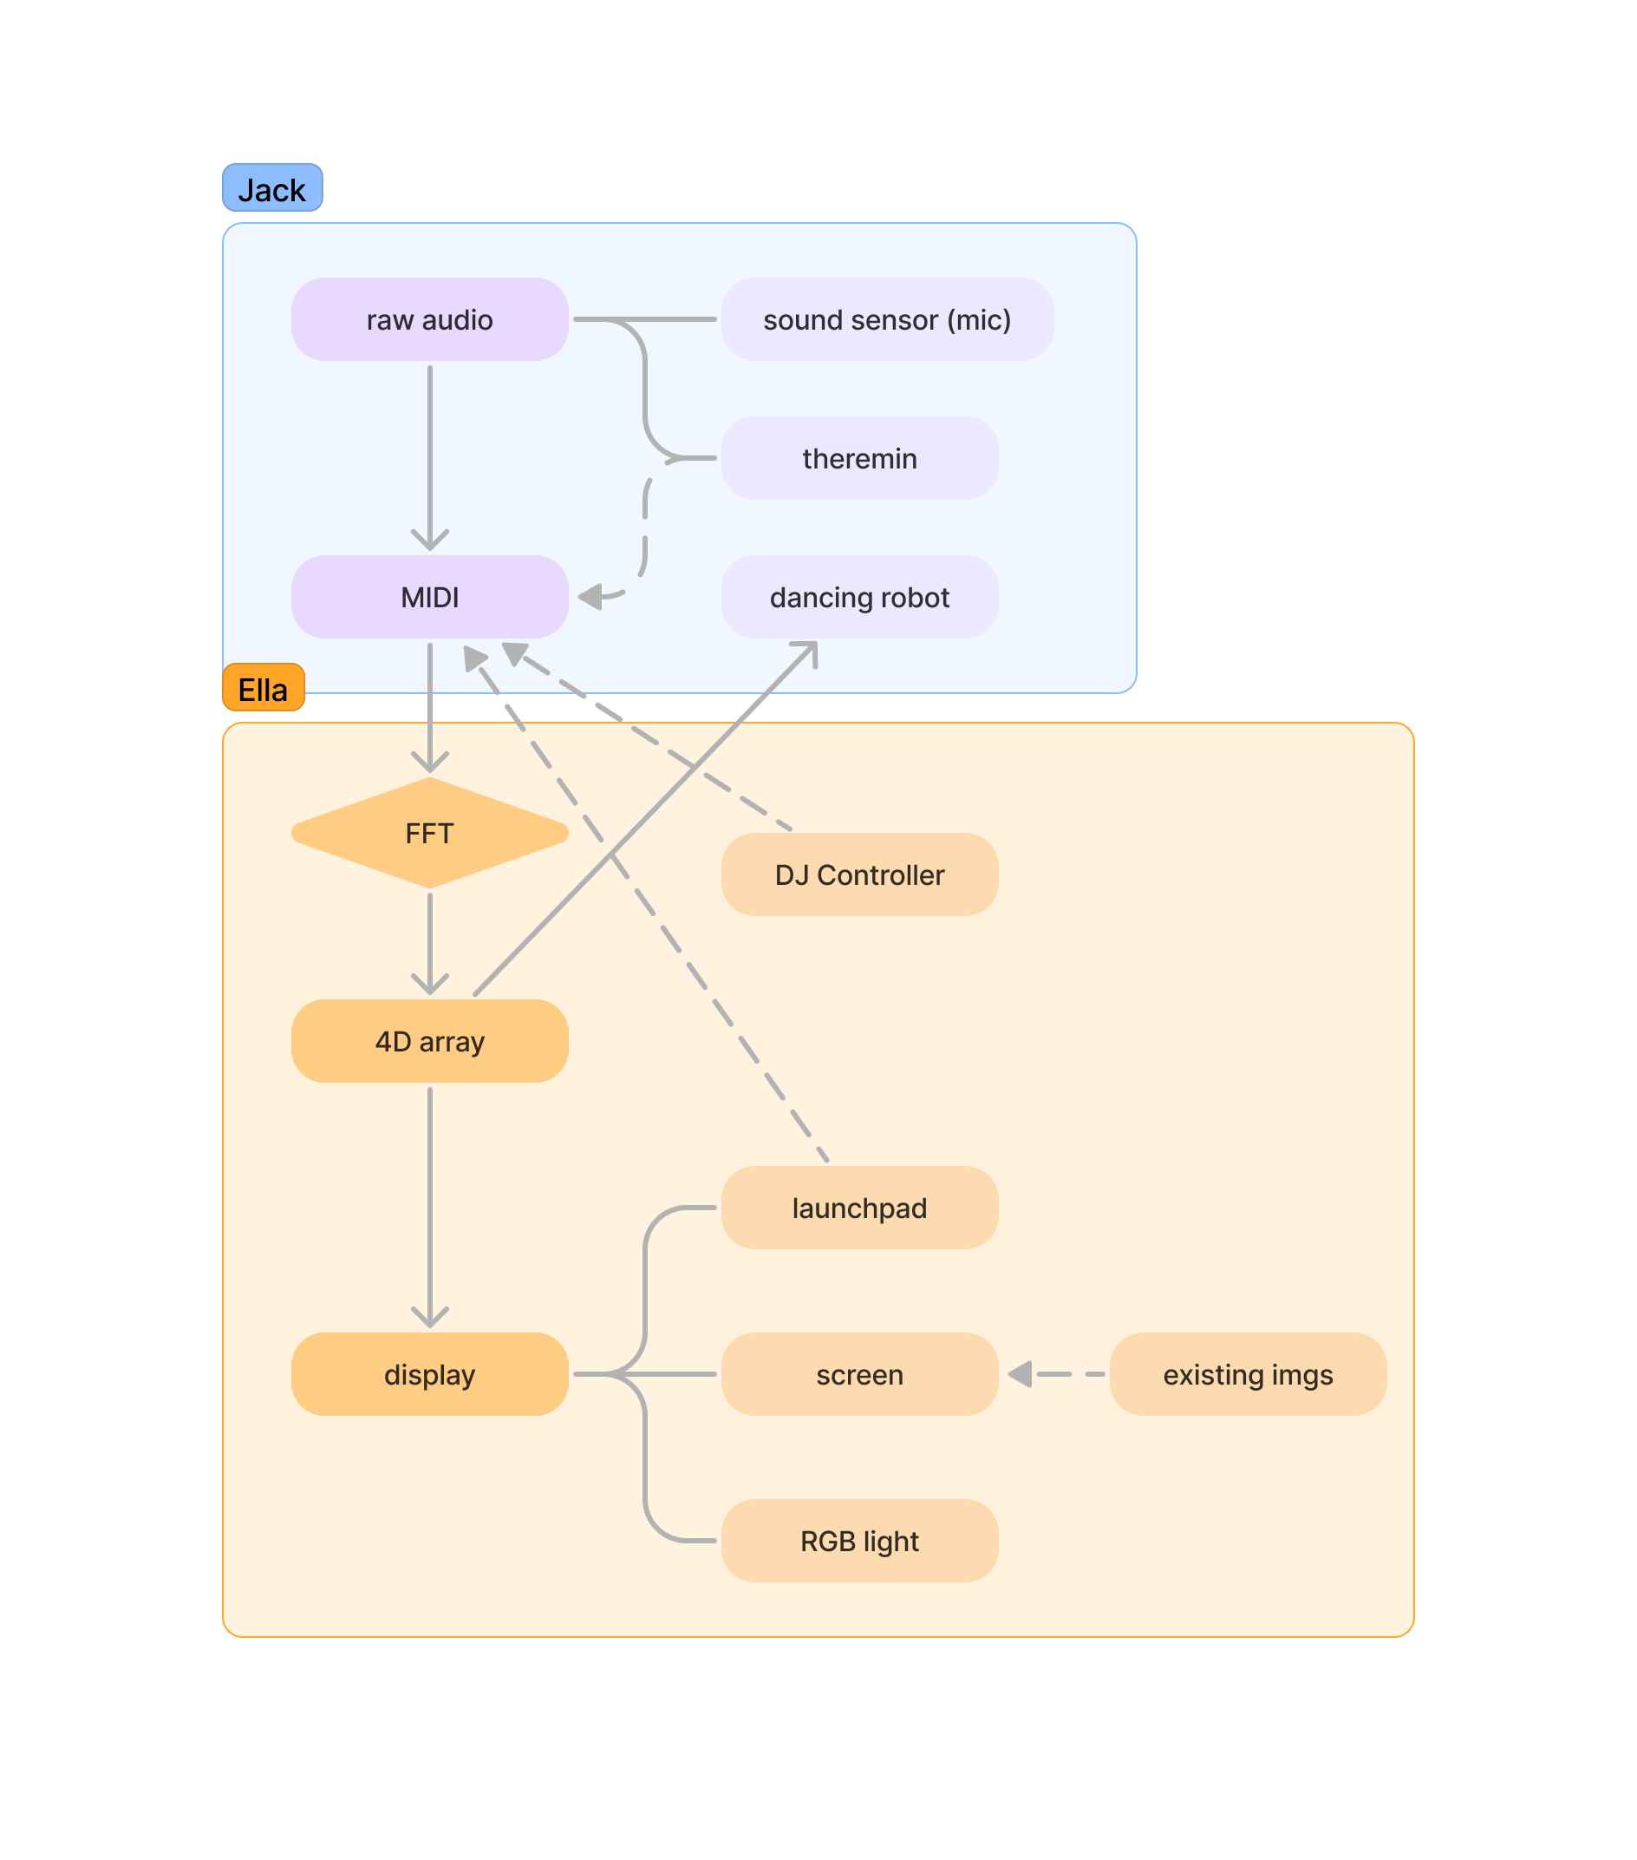
Original Design

Slide 5
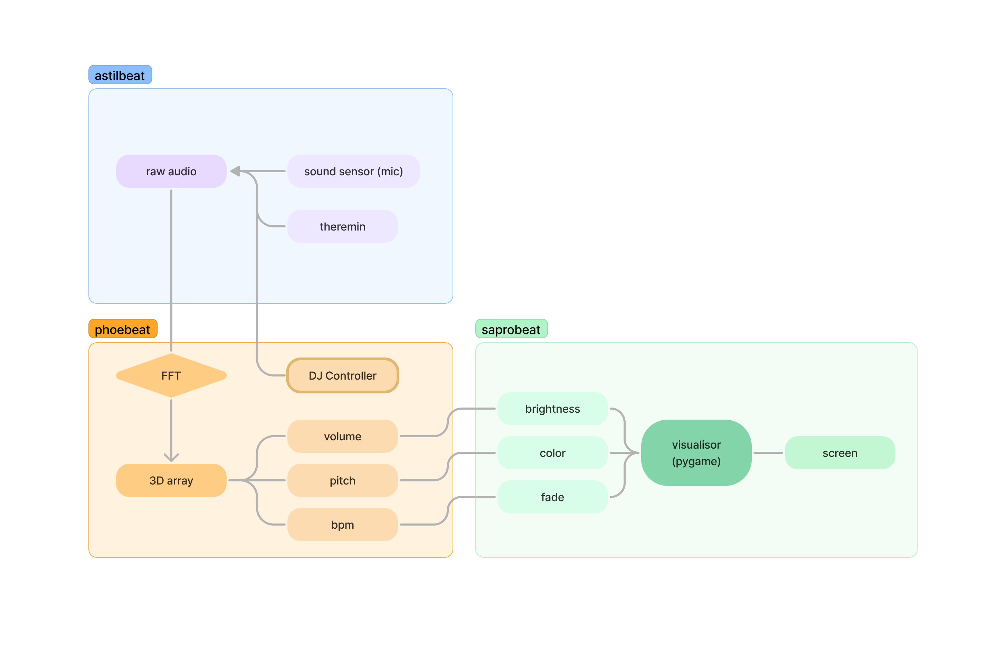
Final Design

Slide 6
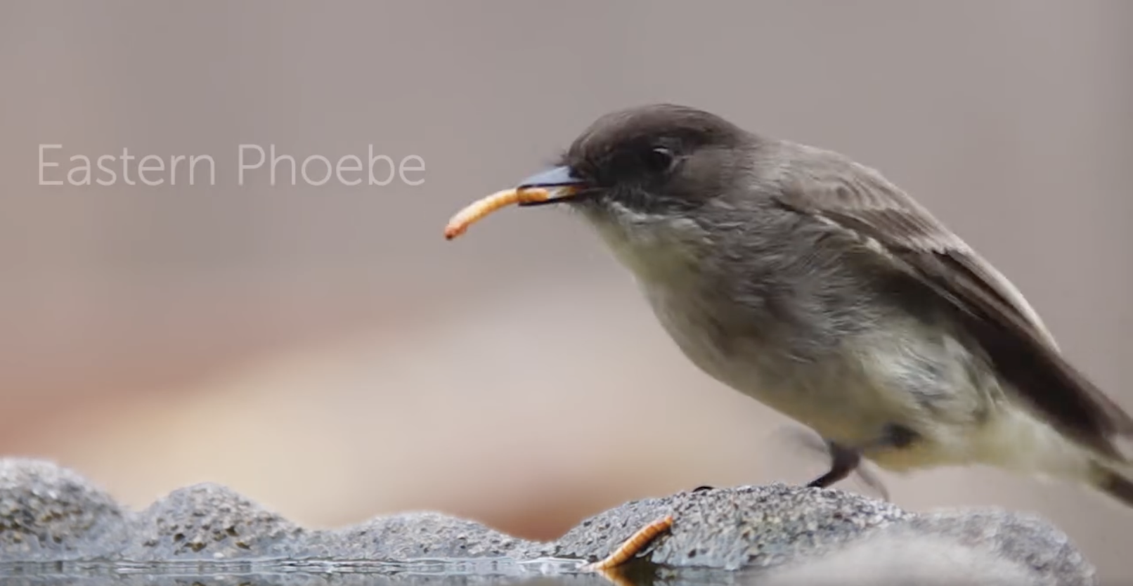
Funny Names
audio -> visual: phoebeat = phoebe flycatcher + beat

Slide 7

Funny Names
visualisor: saprobeat (saprobe := decomposer subtype fungi)

Slide 8

Funny Names
audio input: astilbeat (astilbe := plant w/ tiny white, pink, or red flowers)

Slide 9
Usage
Accessibility
- Make it accessible to people with low musicality or hearing loss

Slide 10
Usage
Accessibility
Visual break down of music

Slide 11
Usage
Accessibility
Visual break down of music
Comparative Analysis
- comparing music genres (subgenres), historical periods, instruments, and performances visually

Slide 12
Usage
Accessibility
Visual break down of music
Comparative Analysis
Music History Timeline
- interactive timeline to explore the development of music over time, aiding in studying music history.

Slide 13
Usage
Accessibility
Visual break down of music
Comparative Analysis
Music History Timeline
Cross-Art Connections
- creating connections among different art styles

Slide 14
Usage
Accessibility
Visual break down of music
Comparative Analysis
Music History Timeline
Cross-Art Connections
Party before & after or even during studying XD

Slide 15
Usage
Accessibility
Visual break down of music
Comparative Analysis
Music History Timeline
Cross-Art Connections
Party before & after or even during studying XD

Slide 16
What We Learnt
C++
Including lots of libs

Slide 17
What We Learnt
C++
Including lots of libs
Flash from ARM chip Mac to Arduino using PlatformIO

Slide 18

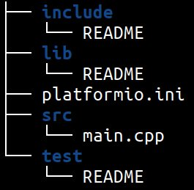
What We Learnt
C++
Including lots of libs
Flash from ARM chip Mac to Arduino using PlatformIO
- Allows ordinary C++
- allows config options for multiple boards!​

Slide 19
What We Learnt
C++
Including lots of libs
Flash from ARM chip Mac to Arduino using PlatformIO
- Allows ordinary C++
- allows config options for multiple boards!​

Slide 20
What We Learnt
C++
Including lots of libs
Flash from ARM chip Mac to Arduino using PlatformIO
Ncurses

Slide 21
What We Learnt
C++
Including lots of libs
Flash from ARM chip Mac to Arduino using PlatformIO
Ncurses
Parsing serial signal via UART

Slide 22
What We Learnt

Slide 23
What We Learnt (THRU PAIN)

Slide 24
What We Learnt (THRU PAIN)
Sound sensor != microphone ???

Slide 25
What We Learnt (THRU PAIN)
Sound sensor != microphone ???
Saturday:
Plenty of time to for platformio shenanigans, right???​

Slide 26
What We Learnt (THRU PAIN)
Sound sensor != microphone ???
Saturday:
Plenty of time to for platformio shenanigans, right???​
Sunday:
Hmm, what does this sound sensor even do?​ - Volume only :(​
​

Slide 27
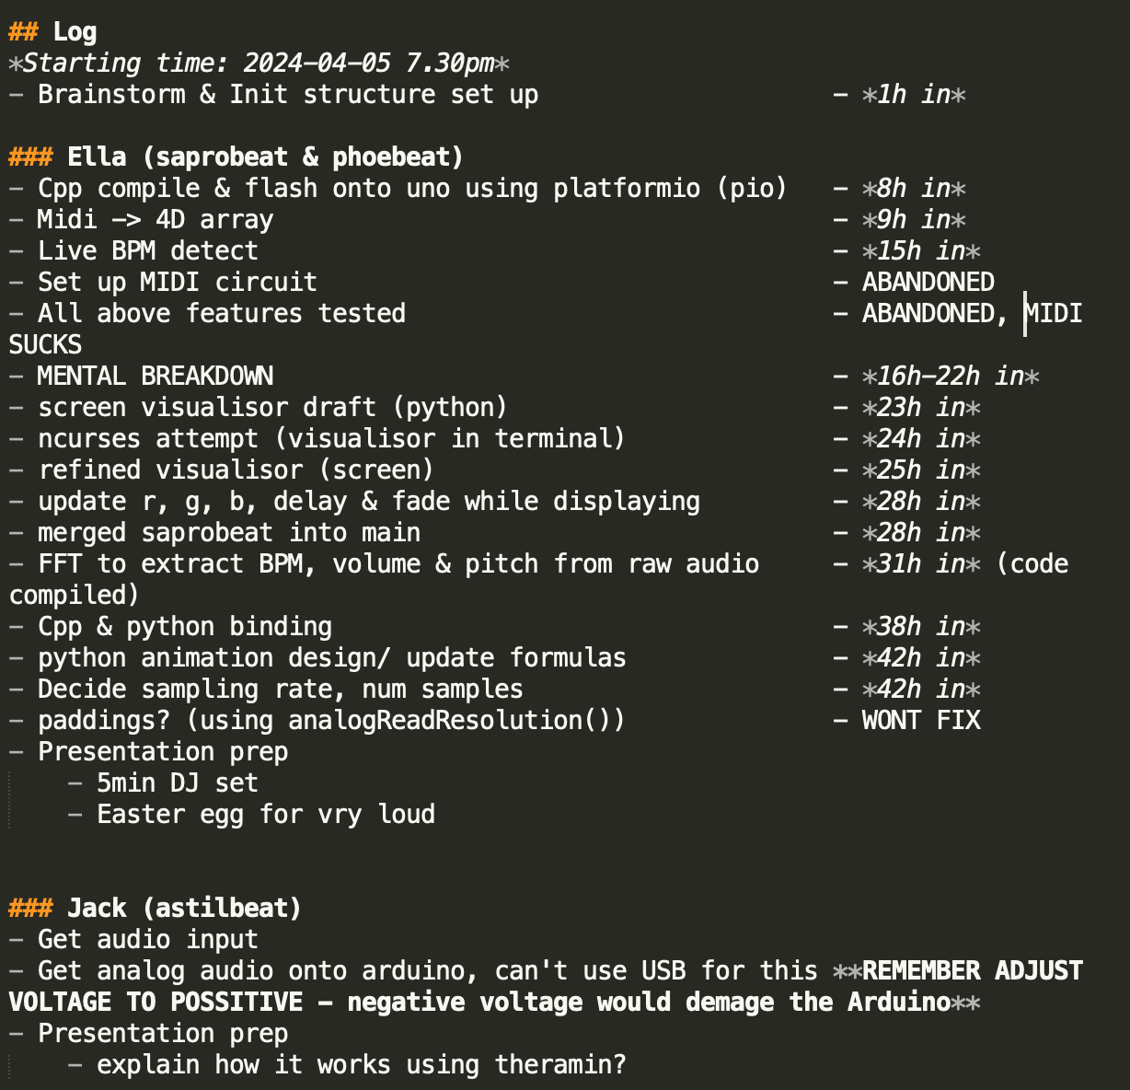
DEV LOG

